Slide 1

CRRT
Dr. Amirhesam Alirezaei
Assistant professor of Nephrology
SBMU – Modarres Hospital

Slide 2
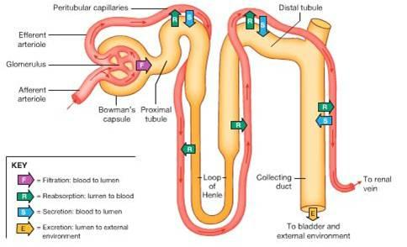
Urinary excretion of solutes :

Slide 3
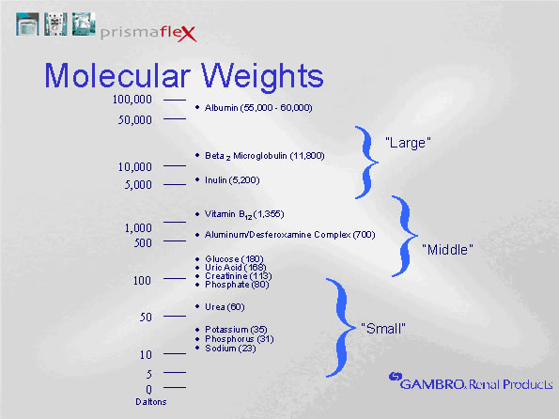

Slide 4
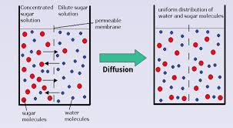
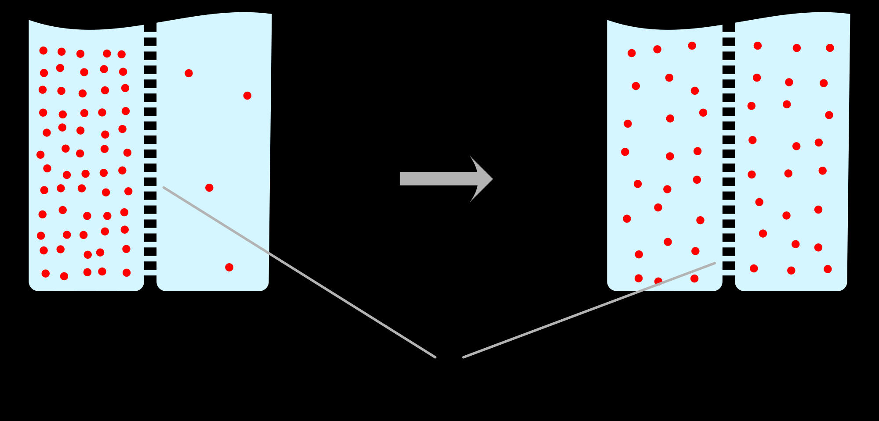
Diffusion :

Slide 5
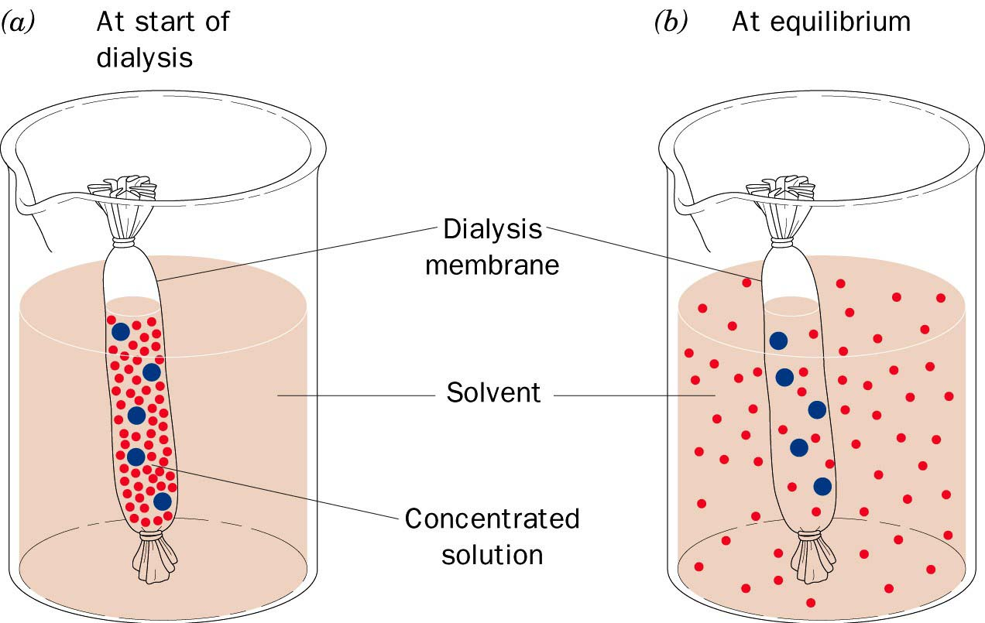

Slide 6
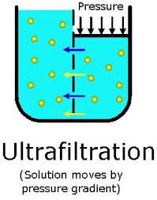

Convection / Ultrafiltration :

Slide 7
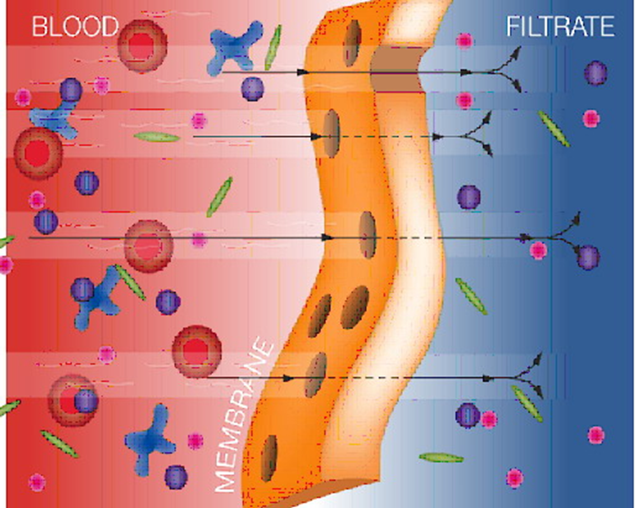
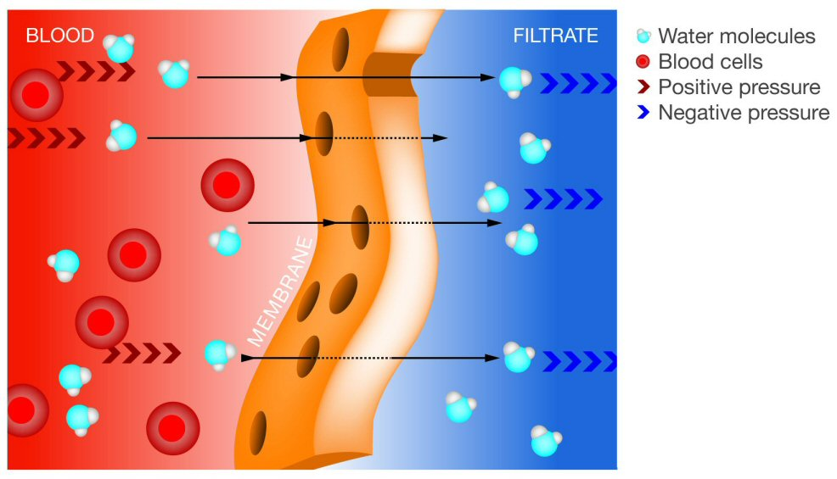

Slide 8
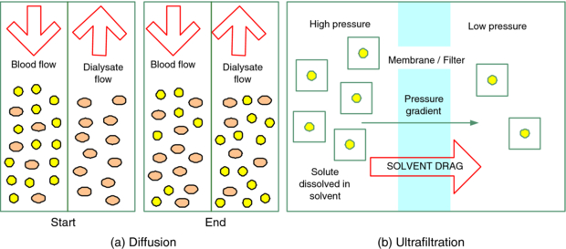

Slide 9
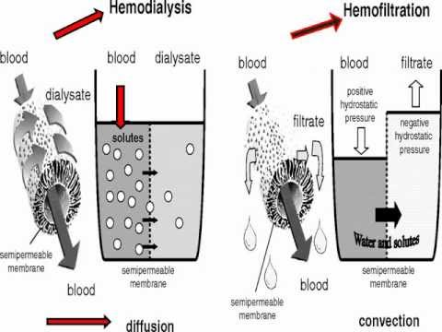

Slide 10
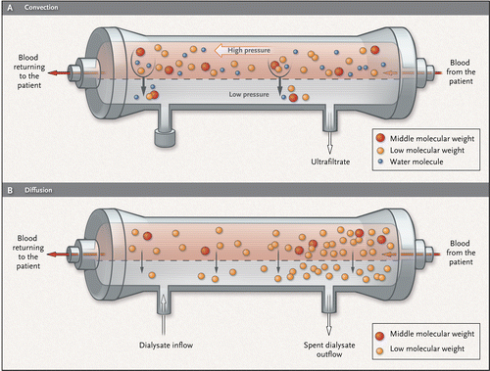

Slide 11
Types of CRRT Therapy
Slow Continuous Ultrafiltration (SCUF)
Continuous VenoVenous Hemofiltration (CVVH)
Continuous VenoVenous HemoDialysis (CVVHD)
Continuous VenoVenous HemoDiaFiltration (CVVHDF)

Slide 12
Continuous Veno-venous Hemofiltration (CVVH)

Slide 13
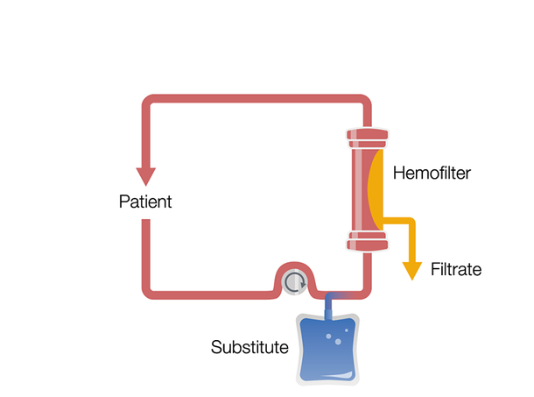
Continuous Veno-Venous Hemofiltration in pre-dilution (Pre-CVVH)

Slide 14
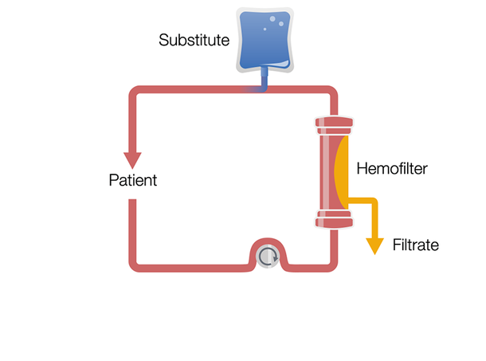
Continuous Veno-Venous Hemofiltration in post-dilution (Post-CVVH)

Slide 15
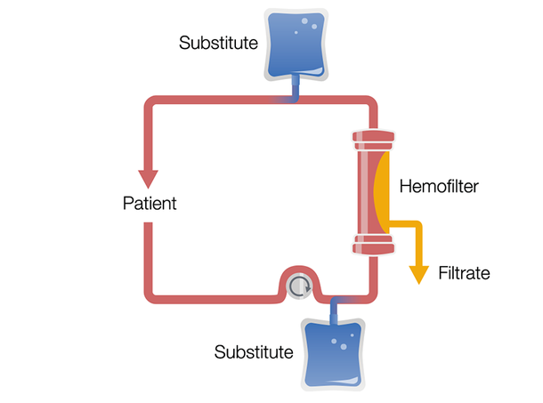
Continuous Veno-Venous Hemofiltration in pre-and postdilution (Pre-Post CVVH)

Slide 16
Continuous Veno-venous Hemodialysis (CVVHD)

Slide 17
Continuous Veno-venous Hemodiafiltration (CVVHDF)

Slide 18
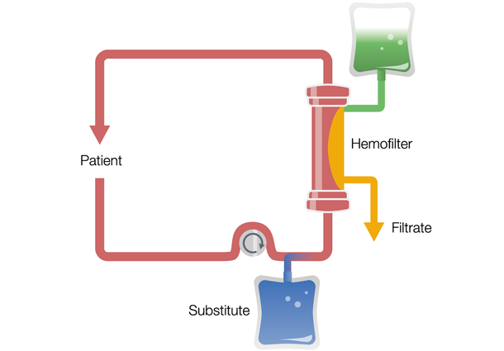
Continuous Veno-Venous Hemodiafiltration in predilution (Pre-CVVHDF)

Slide 19
Slow Continuous Ultrafiltration (SCUF)

Slide 20
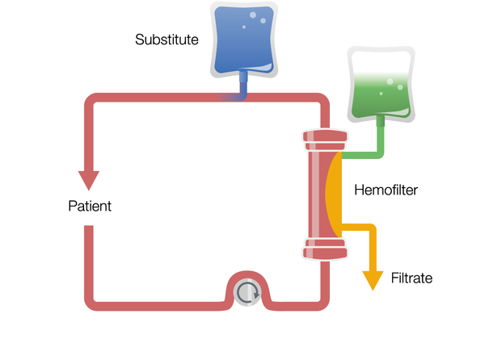
Continuous Veno-Venous Hemodiafiltration in postdilution (Post-CVVHDF)

Slide 21
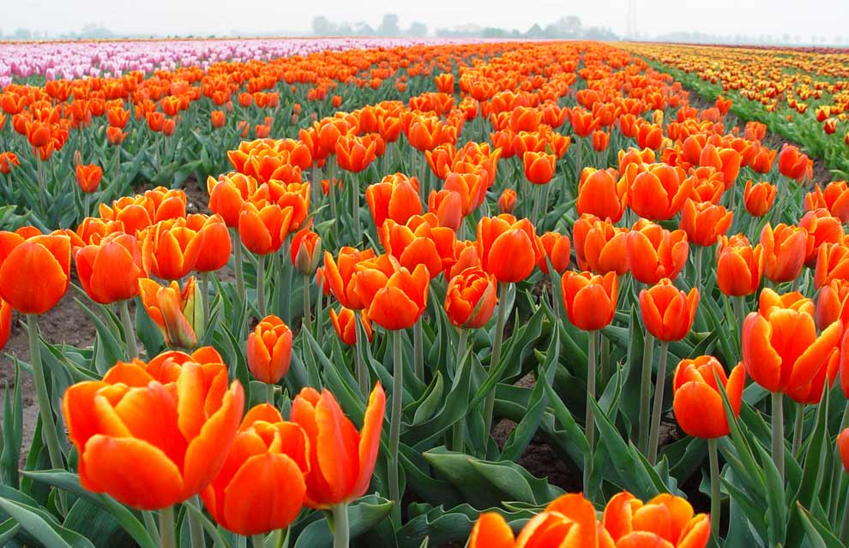
خسته نباشید

